Slide 1

Sonic logo intro
2024
Guide & tips
Notes:
Sonic Logo audio will play at the start of presentation.

Slide 2
What is a sonic logo and what does it represent?
New sonic logo
Is a distinctive audio signature associated with a company. It's designed to represent and reinforce the brand's identity, values, and personality through sound.
Our sonic logo reinforces our brand attributes of connection, confidence, assurance with the click.

Slide 3
How to use in presentations as demonstrated in this file.
Guide & tips
Opening/Intro slide – audio will play on click when advancing intro slide in slide show mode. See slide 1
Animation outro – Animation with sound will play automatically after advancing from previous slide. Place the animated slide at the end of your presentations - after the “Thank you” or “questions” slide. See slide 5 transition to slide 6
Recommendation: Much like our visual logo, the consistent use of our sonic logo is important, it should be featured on all presentations, and exposed to all internal and external audiences.

Slide 4
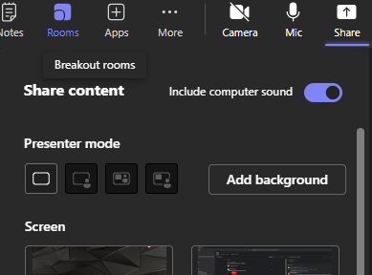
TECH TIP
Remember to turn on the sound when sharing a screen when presenting, this setting in Teams isn't the default, you must toggle the slider before you present.
1
2
3

Slide 5
Questions?
Marketing@cpcworldwide.com
Notes:
Sonic logo will play on click after the final slide.

Slide 6

Notes:
Sonic logo animation with audio will play automatically during a presentation.

